Slide 1



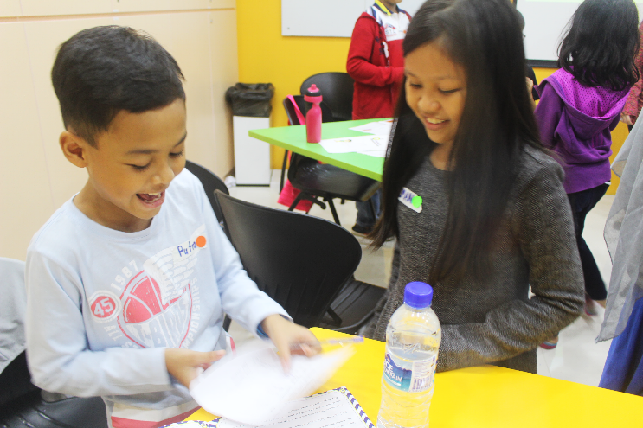








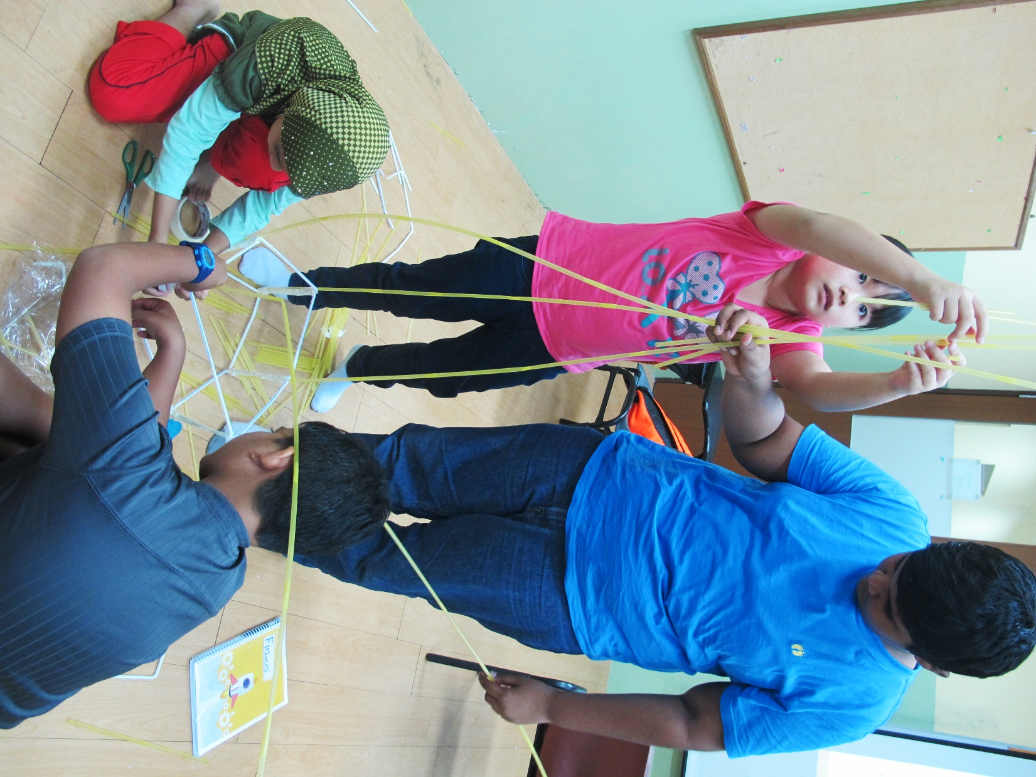
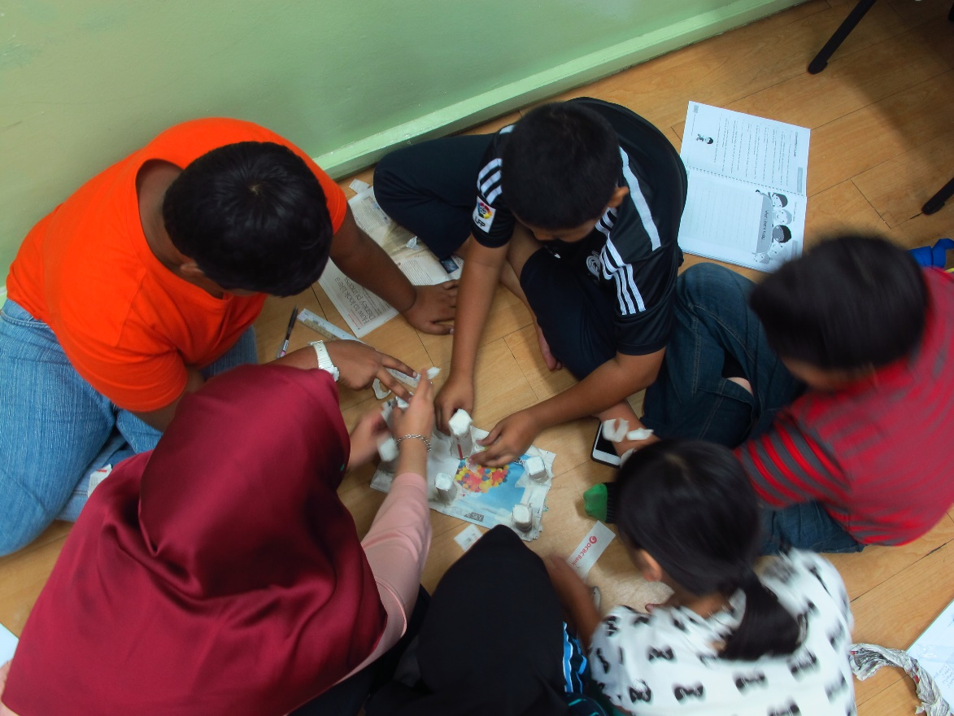
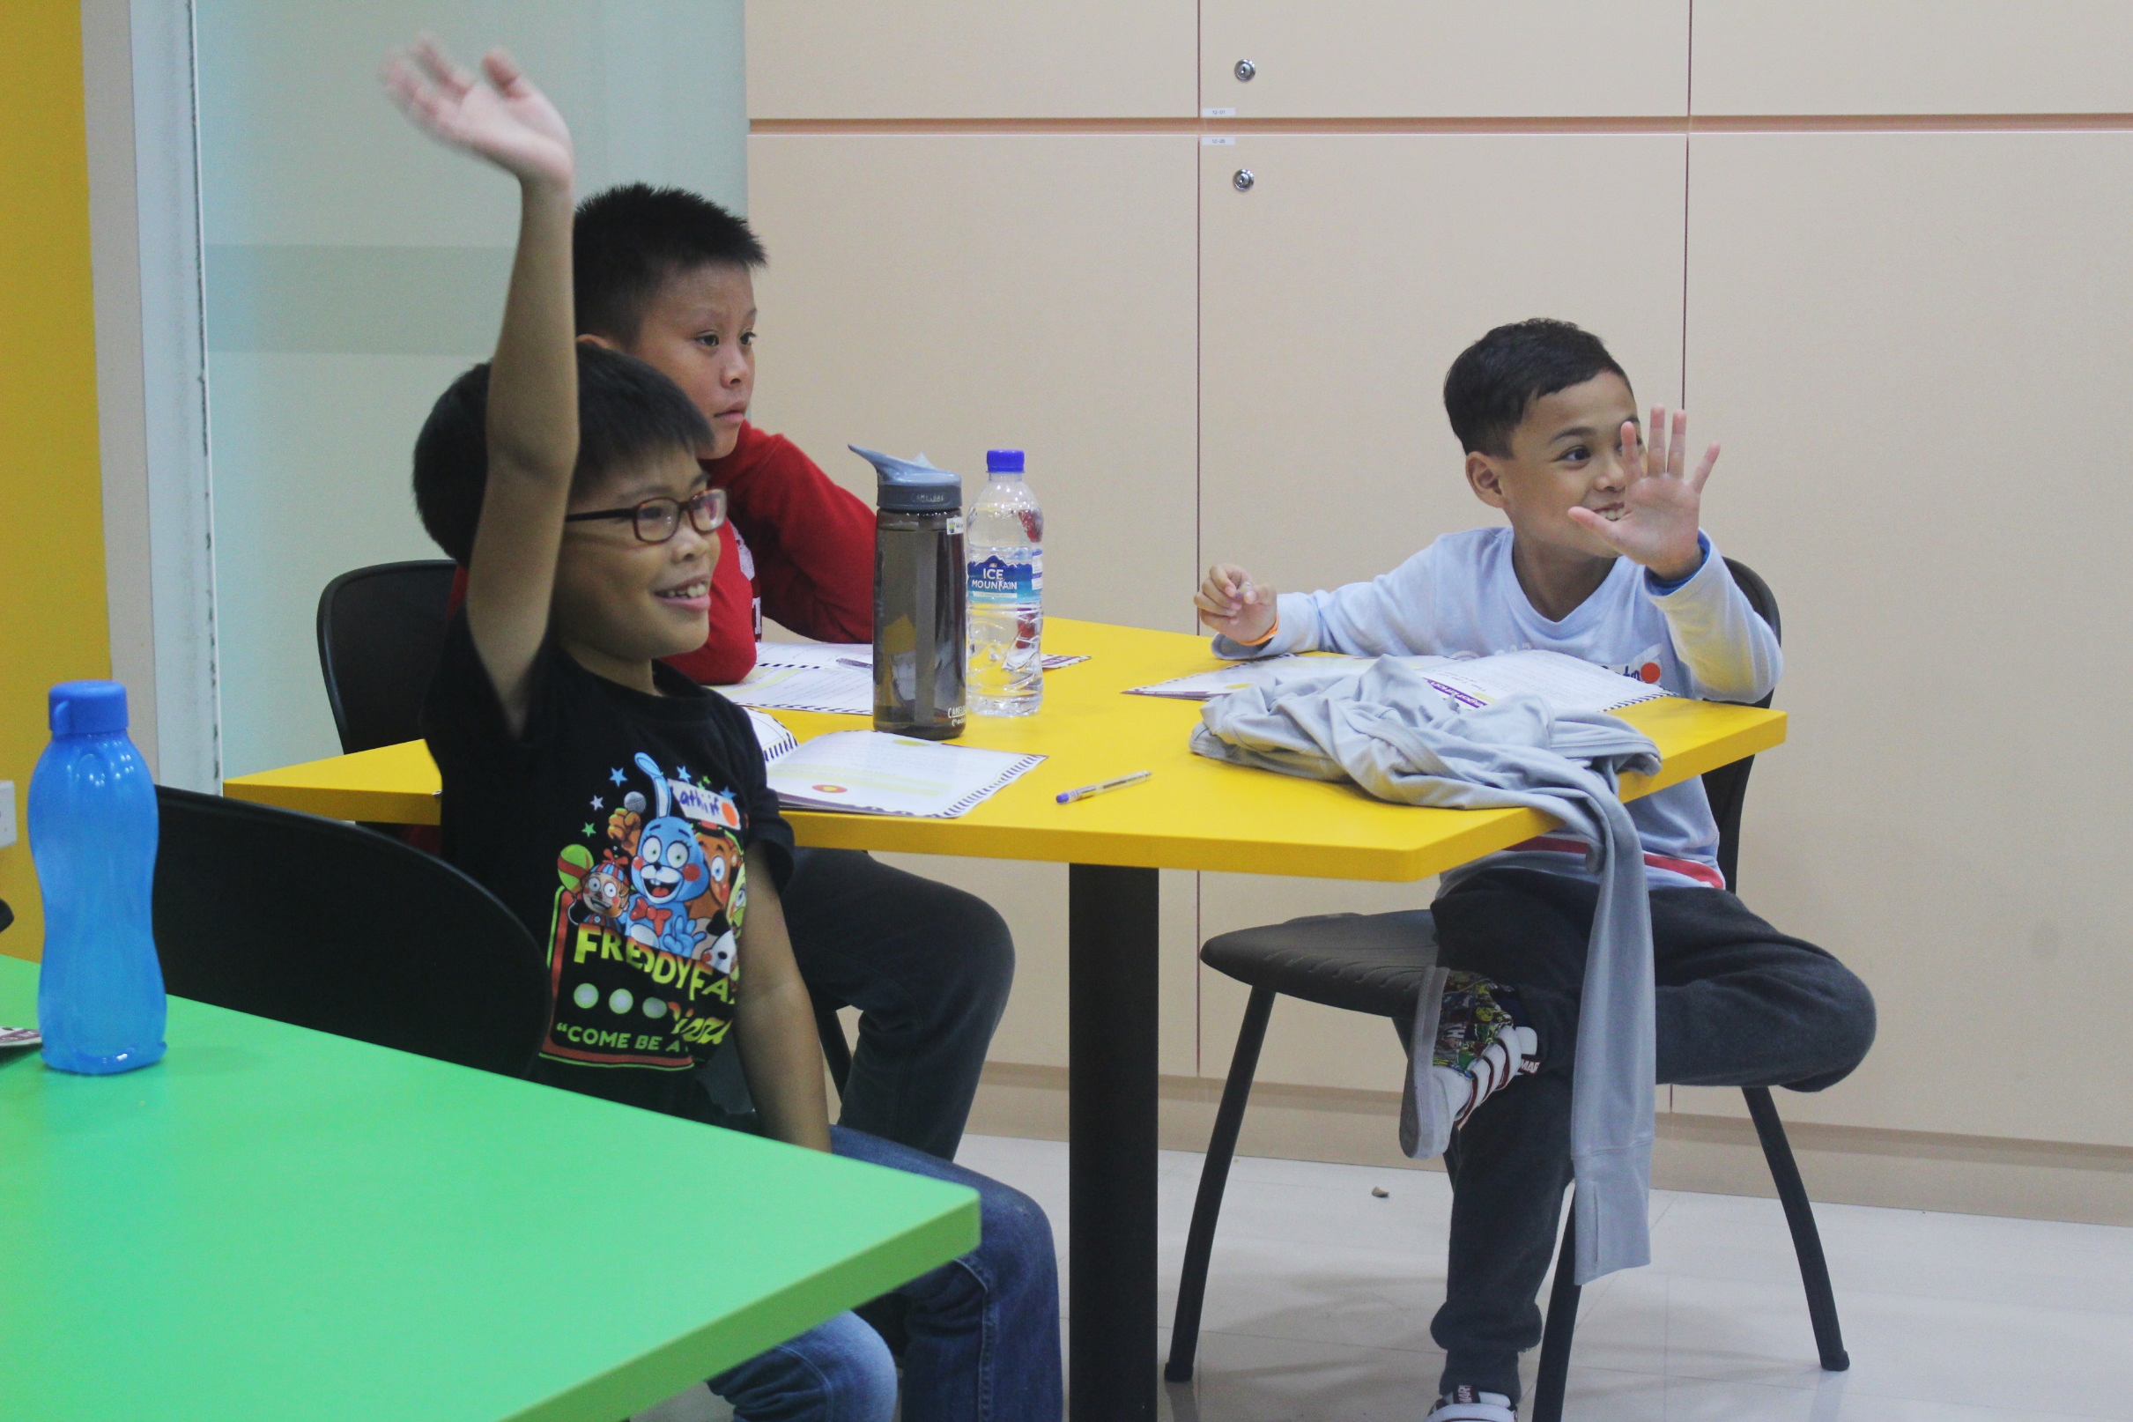







HOME
ABOUT US
PROGRAMMES
SCHEDULE
NEWS & EVENTS
CONTACT
LET’S JOE!
Next animation to change to this testimonial instead
“
During the Journey of Entrepreneurship Bootcamp, I really enjoyed myself and learnt a lot about businesses. There were a lot of fun activities and the trainer was really engaging.
“
“
The activities were an eye-opener for my child. She was exposed to new ways of solving problems and learnt how to work in groups.
“
- Nurul Huda, 9 years old
- Guardian of Shakirah, 10 years old
“Apart from financial literacy, it is also an important responsibility for parents to help their children grow emotionally and socially. We are certain that every single one of them has the ability and the potential to add value to the lives of others, in one way or another by being civil and responsible citizens of the world…”
- CEO’s Message
Who said only
ADULTS
JOE is a holistic
See animation at www.casaraudha.org
4-phased
can be entrepreneurs?
entrepreneurship programme designed for tweens and teens aged 9 - 16
Your child could be the next Mark Zuckerberg.
ENROL NOW!
LEARN MORE
Launch your child’s entrepreneurship journey now!
Redirect to “News & Events” under Photo Gallery
see more photos…
JOE
What’s special about
is that it focuses on both
PERSONAL DEVELOPMENT & FINANCIAL LITERACY
Phase 1
Phase 2
Phase 3
Phase 4
What we learn in JOE
Soft-Skills: Interpersonal Skills
Financial Literacy & Business Skills
Final Project & Mini-Market Fair
Soft-Skills: Mindset Development
Refer to slide 2 for flipside (insert animation when hover)
How we learn in JOE
Learning is made fun at JOE! Many of its activities are experiential-based to create the best learning environment.
Idea Journal
Storytelling
Teamwork
Video Screening
Problem-Solving Games
Real-Life Application
Choose a JOE Programme today!
https://www.amazeelabs.com/en/clients and scroll down to animation
READY? LET’S JOE!
My child’s age
List 9 to 16
I would like to enroll my child for
Holiday Bootcamp (4 + 1 days)
Fast Track (5 months)
Our Programmes
Let’s JOE!
JOE
FAQ
Be Part of JOE
Contact Us
Terms of Services
Find us here!
Facebook
Instagram
Register to our mailing list
An entrepreneurship and financial literacy programme that focuses on the personal development of teens and tweens.
Join!

Slide 2


What we learn in JOE
Phase 4
Phase 1
Phase 2
Phase 3
Final Project & Mini-Market Fair
Creativity
Passion
Perseverance
Risk-Taking
Innovation
Envisioning
Ethics
Soft-Skills: Interpersonal Skills
Financial Literacy & Business Skills
Teamwork
Communication
Networking
Presentation
Negotiation
Time Management
Basic Economics
Basic Business
Competition
Marketing
Financial Planning
Business Planning
Soft-Skills: Mindset Development
Putting knowledge into application

Slide 3
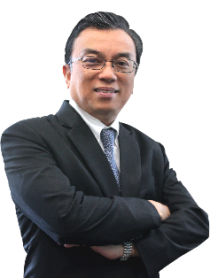
HOME
ABOUT US
PROGRAMMES
SCHEDULE
NEWS & EVENTS
CONTACT
LET’S JOE!
CEO’S MESSAGE
CEO’S MESSAGE
VISION & MISSION
“Apart from financial literacy, it is also an important responsibility for parents to help their children grow emotionally and socially. We are certain that every single one of them has the ability and the potential to add value to the lives of others, in one way or another by being civil and responsible citizens of the world…”
OUR PERSONALITY
OUR CENTRES
read more…
OUR INSTRUCTORS
Mr. Suhaimi Salleh

Slide 4

HOME
ABOUT US
PROGRAMMES
SCHEDULE
NEWS & EVENTS
CONTACT
LET’S JOE!
About Us
CEO’S MESSAGE
It was not too long ago when the Singapore government realised that the spirit of entrepreneurship was lacking in the city state. Our leaders had the vision of Singapore to become a Smart Nation. But to actualise that vision, we needed an entrepreneurial culture. A culture that dares to dream, dares to fail and dares to take on big challenges.
Our mission in JOE is to provide a unique learning experience to children in helping them develop an entrepreneurial mindset through experiential learning in order for them to add significant value to the world.
JOE was designed to create awareness amongst children to think out-of-the-box and not be limited in how they approach and solve problems. As these children grow up, they will be dealing with problems that no one has solved before. Therefore, a creative and entrepreneurial mindset will truly be an asset for life. Which is why in JOE, we encourage students to see problems as opportunities instead of a burden. The developers of JOE believes in a non-conformist thinking where students are given a conducive environment and latitude to think-out-of-the-box and exercise their thinking skills and innovative spirit. The common method of instruction in JOE is to question. We probe children with questions and at the same time, get them to ask questions. We believe that a questioning attitude will help to open up their minds.
It is a common misconception that entrepreneurship is synonymous to financial literacy. Entrepreneurship is a mindset more than anything else. Journey of Entrepreneurship is not just about financial literacy, but it has been designed to include both soft skills and financial literacy. Apart from financial literacy, it is also an important responsibility for parents to help their children grow emotionally and socially. We are certain that every single one of them has the ability and the potential to add value to the lives of others, in one way or another by being civil and responsible citizens of the world.
We want our children to grow up making decisions that are not merely based on money but crafted by their passion or desire to make an impact to society. Money is a means – not an end. Create a forgiving environment – one that does not diminish a child’s sense of well-being when they fail. This is detrimental to promoting entrepreneurship. An environment which celebrates people who have tried but failed is instrumental in creating an entrepreneurial landscape in the world.
This world is not problem-free. It was never meant to be. But it is unsettling how we see more and more problems as the world matures. Poverty, global warming, pollution, energy crisis, starvation… the list goes on. We do not want to be the generation that is known to have conveniently handed over a list of problems to the next generations to come. Yes, problems are inevitable. But what if we could do the future a service and hand them over a solution “package”? A “package” that leads to breakthrough solutions in overcoming problems of the future. That “package” would be an entrepreneurial mindset.
Suhaimi Salleh, CEO
CEO’S MESSAGE
VISION & MISSION
OUR PERSONALITY
OUR CENTRES
OUR INSTRUCTORS
Mr. Suhaimi Salleh
Choose a JOE Programme today!
READY? LET’S JOE!
My child’s age
I would like to enroll my child for
Our Programmes
Let’s JOE!
JOE
FAQ
Be Part of JOE
Contact Us
Terms of Services
Find us here!
Facebook
Instagram
Register to our mailing list
An entrepreneurship and financial literacy programme that focuses on the personal development of teens and tweens.
Join!

Slide 5
HOME
ABOUT US
PROGRAMMES
SCHEDULE
NEWS & EVENTS
CONTACT
LET’S JOE!
About Us
VISION
CEO’S MESSAGE
To be a global brand in entrepreneurship training for teens and tweens
VISION & MISSION
OUR PERSONALITY
MISSION
OUR CENTRES
To provide a unique learning experience to children in helping them to develop an entrepreneurial mindset through experiential learning in order for them to add significant value to the world.
OUR INSTRUCTORS
Choose a JOE Programme today!
READY? LET’S JOE!
My child’s age
I would like to enroll my child for
Our Programmes
Let’s JOE!
JOE
FAQ
Be Part of JOE
Contact Us
Terms of Services
Find us here!
Facebook
Instagram
Register to our mailing list
An entrepreneurship and financial literacy programme that focuses on the personal development of teens and tweens.
Join!

Slide 6
HOME
ABOUT US
PROGRAMMES
SCHEDULE
NEWS & EVENTS
CONTACT
LET’S JOE!
About Us
OUR PERSONALITY
CEO’S MESSAGE
VISION & MISSION
OUR PERSONALITY
Inquisitive
OUR CENTRES
Children are born explorers and are always asking questions. At JOE, we are constantly posing our students questions and encouraging them to fuel their never ending curiosity.
OUR INSTRUCTORS
Innovative
Our programme assists students in ideation which requires a lot of out-of-the-box thinking. Our approach in coaching these young entrepreneurs is to get them to see things from the bigger picture.
Passionate
Just as we are passionate about what we do, we want our students to discover their passion to uncover the uniqueness within them. Passion is like the fuel to their vehicle – the driving force behind success.
Failure-Tolerant
Entrepreneurship is never just about the happy stories. Most entrepreneurs would have many stories about failure to share. In JOE, our activities would sometimes lead to failure on the part of the students. With reflection, students can emerge from these programme more persevering and failure-tolerant.
Choose a JOE Programme today!
READY? LET’S JOE!
My child’s age
I would like to enroll my child for
Our Programmes
Let’s JOE!
JOE
FAQ
Be Part of JOE
Contact Us
Terms of Services
Find us here!
Facebook
Instagram
Register to our mailing list
An entrepreneurship and financial literacy programme that focuses on the personal development of teens and tweens.
Join!

Slide 7
HOME
ABOUT US
PROGRAMMES
SCHEDULE
NEWS & EVENTS
CONTACT
LET’S JOE!
About Us
OUR CENTRES
CEO’S MESSAGE
VISION & MISSION
Headquarters
OUR PERSONALITY
11 Eunos Road 8 #07-01 (Lobby A)
Lifelong Learning Institute
Singapore 408601
OUR CENTRES
OUR INSTRUCTORS
Paya Lebar
60 Paya Lebar Road #02-12
Paya Lebar Square
Singapore 409051
Tel: 6632 9514
E-mail: joe@ssagroup.com
Interested to franchise JOE? E-mail license@ssagroup.com to enquire.
Choose a JOE Programme today!
READY? LET’S JOE!
My child’s age
I would like to enroll my child for
Our Programmes
Let’s JOE!
JOE
FAQ
Be Part of JOE
Contact Us
Terms of Services
Find us here!
Facebook
Instagram
Register to our mailing list
An entrepreneurship and financial literacy programme that focuses on the personal development of teens and tweens.
Join!

Slide 8
HOME
ABOUT US
PROGRAMMES
SCHEDULE
NEWS & EVENTS
CONTACT
LET’S JOE!
About Us
OUR INSTRUCTORS
CEO’S MESSAGE
VISION & MISSION
Our engaging instructors are qualified trainers with a minimum academic qualification of a diploma in business-related subjects.
OUR PERSONALITY
OUR CENTRES
OUR INSTRUCTORS
Choose a JOE Programme today!
READY? LET’S JOE!
My child’s age
I would like to enroll my child for
Our Programmes
Let’s JOE!
JOE
FAQ
Be Part of JOE
Contact Us
Terms of Services
Find us here!
Facebook
Instagram
Register to our mailing list
An entrepreneurship and financial literacy programme that focuses on the personal development of teens and tweens.
Join!

Slide 9



HOME
ABOUT US
PROGRAMMES
SCHEDULE
NEWS & EVENTS
CONTACT
LET’S JOE!
JOE HOLIDAY BOOTCAMP
JOE FAST TRACK
JOE@SCHOOL
(coming soon)

Slide 10

HOME
ABOUT US
PROGRAMMES
SCHEDULE
NEWS & EVENTS
CONTACT
LET’S JOE!
Programmes
JOE HOLIDAY BOOTCAMP
JOE Holiday Bootcamp
JOE FAST TRACK
Perfect for teens and tweens (aged 9 to 16) who have ample free time during their school holidays, the JOE Holiday Bootcamp is a 4 full-day programme which will end with the Mini-Market Fair on the 5th day – a platform for students to experience being an entrepreneur themselves!
The programme covers all 4 phases of JOE’s holistic syllabus but is a more condensed version of JOE Fast Track. The best part is, breakfast, lunch and tea breaks are included!
Each session starts at 830am and ends 630am for the first 4 days. Details of the Mini-Market Fair can be found in the programme schedule.
JOE@SCHOOL
JOE FAST TRACK
JOE@SCHOOL
(coming soon)
see course outline
Choose a JOE Programme today!
READY? LET’S JOE!
My child’s age
I would like to enroll my child for
Our Programmes
Let’s JOE!
JOE
FAQ
Be Part of JOE
Contact Us
Terms of Services
Find us here!
Facebook
Instagram
Register to our mailing list
An entrepreneurship and financial literacy programme that focuses on the personal development of teens and tweens.
Join!

Slide 11

HOME
ABOUT US
PROGRAMMES
SCHEDULE
NEWS & EVENTS
CONTACT
LET’S JOE!
Programmes
JOE HOLIDAY BOOTCAMP
JOE Fast Track
JOE FAST TRACK
Designed as an after-school programme, the JOE Fast Track spans over 5 months with 20 sessions of 2 hours each. At the end of the programme, students take part in the Mini-Market Fair - a platform to be entrepreneurs themselves!
The programme covers all 4 phases of JOE’s holistic syllabus and covers each module in depth, giving students time for greater contemplation and reflection as they go back and put more thought to the tasks given.
Details of the Mini-Market Fair can be found in the programme schedule.
JOE@SCHOOL
JOE@SCHOOL
(coming soon)
see course outline
Choose a JOE Programme today!
READY? LET’S JOE!
My child’s age
I would like to enroll my child for
Our Programmes
Let’s JOE!
JOE
FAQ
Be Part of JOE
Contact Us
Terms of Services
Find us here!
Facebook
Instagram
Register to our mailing list
An entrepreneurship and financial literacy programme that focuses on the personal development of teens and tweens.
Join!

Slide 12

HOME
ABOUT US
PROGRAMMES
SCHEDULE
NEWS & EVENTS
CONTACT
LET’S JOE!
Programmes
JOE HOLIDAY BOOTCAMP
JOE@School
JOE FAST TRACK
Still under development, JOE@School is designed for students in both private and public schools.
The 12-hour long programme is short and sweet – not compromising the entrepreneurship lessons to be imparted to the students!
The Mini-Market Fair is not included in JOE@School. All sign-ups for JOE@School has to be done through the school.
JOE@SCHOOL
Choose a JOE Programme today!
READY? LET’S JOE!
My child’s age
I would like to enroll my child for
Our Programmes
Let’s JOE!
JOE
FAQ
Be Part of JOE
Contact Us
Terms of Services
Find us here!
Facebook
Instagram
Register to our mailing list
An entrepreneurship and financial literacy programme that focuses on the personal development of teens and tweens.
Join!

Slide 13
HOME
ABOUT US
PROGRAMMES
SCHEDULE
NEWS & EVENTS
CONTACT
LET’S JOE!
Schedule
Junior (9-12 yo): 21 Nov – 24 Nov 2016
Mini-Market Fair: 26 Nov (10AM – 4PM)
Teen (13-16 yo): 28 Nov – 1 Dec 2016
Mini-Market Fair: 3 Dec (10AM – 4PM)
Venue: Paya Lebar Square #02-12
Time: 830AM – 630PM
JOE HOLIDAY BOOTCAMP
Junior (9-12 yo): Wednesdays, 4 Jan 2017 – 17 May 2017 20 sessions | 2PM – 4PM
Mini-Market Fair: 20 May (10AM – 4PM)
Teen (13-16 yo): Wednesdays, 4 Jan 2017 – 17 May 2017
20 sessions | 415PM – 615PM Mini-Market Fair: 20 May (10AM – 4PM)
Venue: Paya Lebar Square #02-12
Time: 830AM – 630PM
JOE FAST TRACK
Choose a JOE Programme today!
READY? LET’S JOE!
My child’s age
I would like to enroll my child for
Our Programmes
Let’s JOE!
JOE
FAQ
Be Part of JOE
Contact Us
Terms of Services
Find us here!
Facebook
Instagram
Register to our mailing list
An entrepreneurship and financial literacy programme that focuses on the personal development of teens and tweens.
Join!

Slide 14
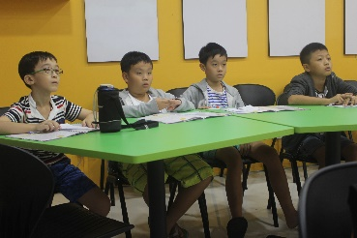
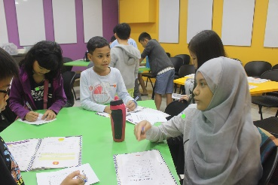
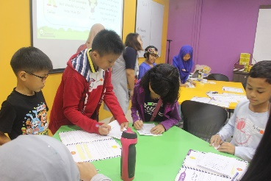
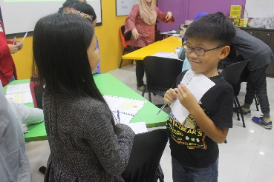
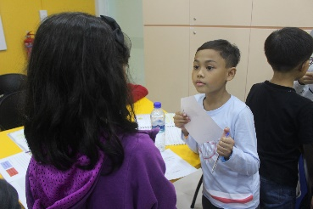

HOME
ABOUT US
PROGRAMMES
SCHEDULE
NEWS & EVENTS
CONTACT
LET’S JOE!
News & Events
Photo Gallery
Hover over the picture and it pops out
JOE Trial Run
Get a feel of what JOE has to offer. Come for a free trial!
Read more...
Choose a JOE Programme today!
READY? LET’S JOE!
My child’s age
I would like to enroll my child for
Our Programmes
Let’s JOE!
JOE
FAQ
Be Part of JOE
Contact Us
Terms of Services
Find us here!
Facebook
Instagram
Register to our mailing list
An entrepreneurship and financial literacy programme that focuses on the personal development of teens and tweens.
Join!

Slide 15

HOME
ABOUT US
PROGRAMMES
SCHEDULE
NEWS & EVENTS
CONTACT
LET’S JOE!
Contact
Headquarters
11 Eunos Road 8 #07-01 (Lobby A)
Lifelong Learning Institute
Singapore 408601
For general enquiries, please contact 6632 9514 / 6632 9519, or email joe@ssagroup.com
For franchising enquiries, please contact 6632 9530 or email license@ssagroup.com
https://www.facebook.com/letsjoe.sg/
Choose a JOE Programme today!
READY? LET’S JOE!
My child’s age
I would like to enroll my child for
Our Programmes
Let’s JOE!
JOE
FAQ
Be Part of JOE
Contact Us
Terms of Services
Find us here!
Facebook
Instagram
Register to our mailing list
An entrepreneurship and financial literacy programme that focuses on the personal development of teens and tweens.
Join!

Slide 16
HOME
ABOUT US
PROGRAMMES
SCHEDULE
NEWS & EVENTS
CONTACT
LET’S JOE!
Registration Form
My child’s full name
My child’s age
My child’s I/C no.
I would like to enroll my child for
Parent’s/Guardian’s name
Contact number
Email address
Newspaper
Magazine
Facebook
Referral
Poster
Walk-by
Roadshow
Others
I got to know about JOE from
LAUNCH!
Choose a JOE Programme today!
READY? LET’S JOE!
My child’s age
I would like to enroll my child for
Our Programmes
Let’s JOE!
JOE
FAQ
Be Part of JOE
Contact Us
Terms of Services
Find us here!
Facebook
Instagram
Register to our mailing list
An entrepreneurship and financial literacy programme that focuses on the personal development of teens and tweens.
Join!

